Slide 1
Progress on Visual-Symbolic Reasoning in Soar
James Boggs
May 29, 2024

Slide 2


Motivating Example
WOW
spouse is

Slide 3
Motivating Example
Low-level visual processing
High-level symbolic processing
Task:
“How many of the blue object do you need to cover the same area as the green object? Show visual proof.
Objects are green square and blue triangle
Area of a triangle = 0.5b*h, area of a square = b*h
Square has twice as much area, so need two triangles to cover it
After putting one triangle on the square, two half-triangles of green are left, so cut second triangle in half
No more green visible, so we’ve shown we can cover the green object with two of the blue object

Slide 4
Deliberative Reasoning
K1: the store is open every day except Sunday
“System 2” thinking
Agent-controlled
Serial/step-by-step
Iterative
Rules-based
Explicit representation of knowledge
K2: today is Saturday
reason
K3: the store is open today
D1: go to the store
recall
act
O4: the store is closed today
K5: I believe the store was open today (K3)
reason
K6: I was mistaken about K3
K7: I believed K3 because of K1 and K2
D2: reevaluate confidence in K1 an K2
act
K8: high confidence phone has correct date
D1: check date on phone
act
O9: today is Sunday (whoops!)

Slide 5
Proposal
Soar cognitive architecture:
Good for deliberative and symbolic reasoning
Bad for low-level visual processing
Deep learning:
Good for low-level visual processing
Bad for deliberative and symbolic reasoning
Combine the two!

Slide 6
Background
Current SVS
Visual Feature Extraction
Generative Modeling

Slide 7
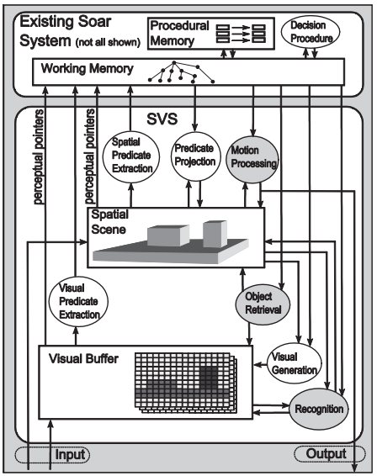
Current Spatial-Visual System
Laird 2012, “The Soar Cognitive Architecture”

Slide 8
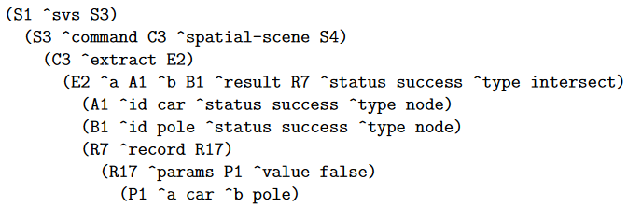
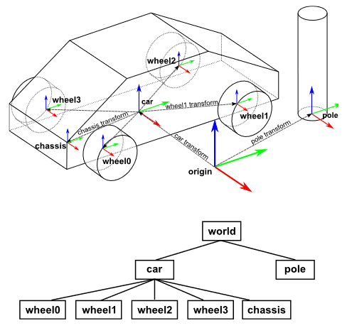
Current SVS: Spatial
Laird 2012, “The Soar Cognitive Architecture”

Slide 9
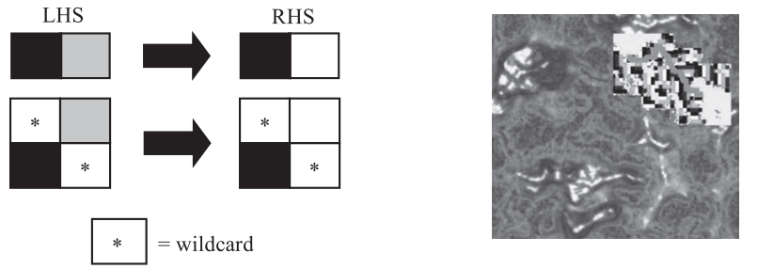
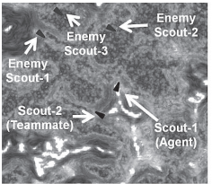
Current SVS: Visual
Laird 2012, “The Soar Cognitive Architecture”

Slide 10
Visual Reasoning Revamp
Overview
Existing Progress: Visual Operations
Current Focus: Visual Knowledge Representation

Slide 11
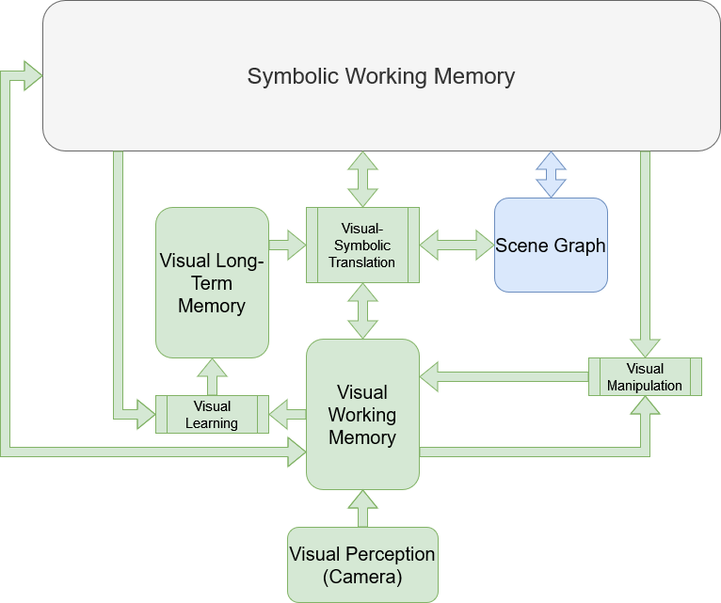
SVS2 Overview
An architecture which enables deliberative visual-symbolic reasoning in Soar
Three key aspects:
Two memories
Three processes
Interconnected with SymWM

Slide 12
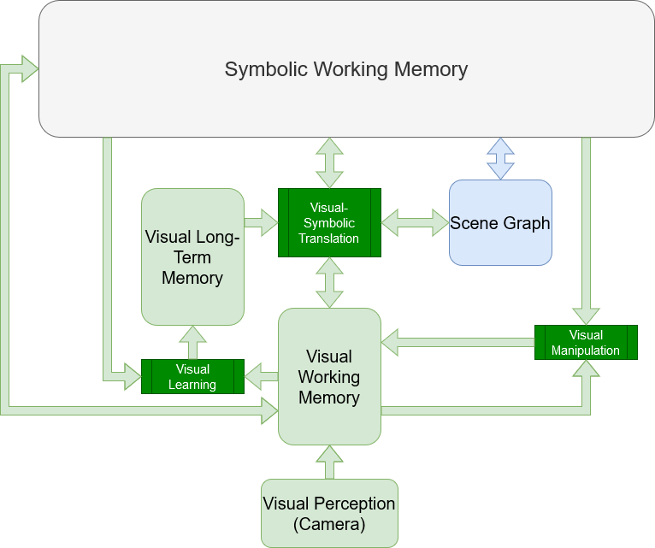
Visual Processes
Visual manipulation:
Transformative: unary
Comparative: binary
Visual-symbolic translation:
Extractive: visual->symbolic
Generative: symbolic->visual
Visual learning:
Symbolic descriptions
Visual experiences

Slide 13
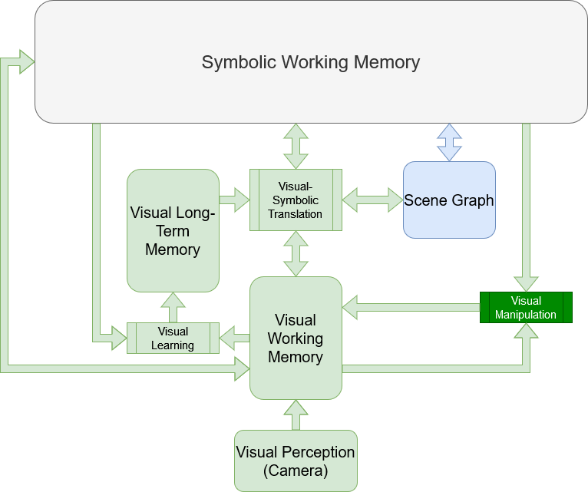





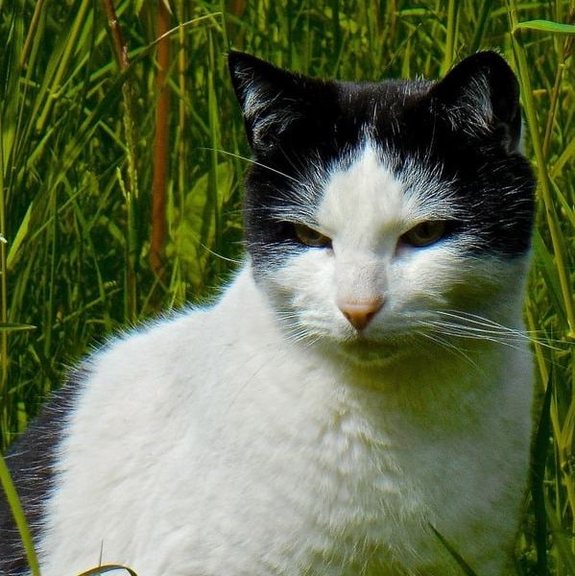
Visual Manipulation Processes
Certain operations only apply to images:
blur
invert
threshold
add

Slide 14
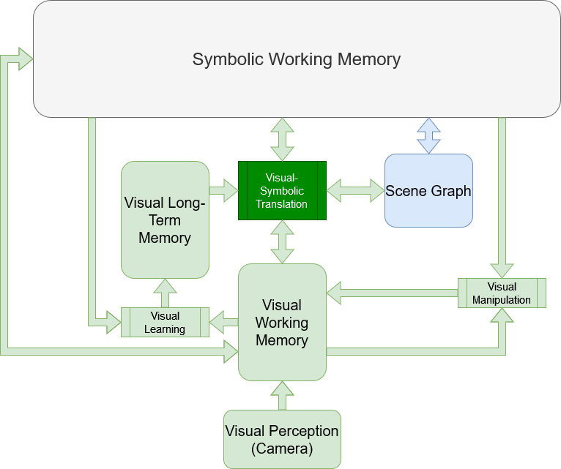

Visual-Symbolic Translation Processes
Extractive: visual->symbolic
classify
“cat”
segment
Generative: symbolic->visual
“cat”
generate

Slide 15
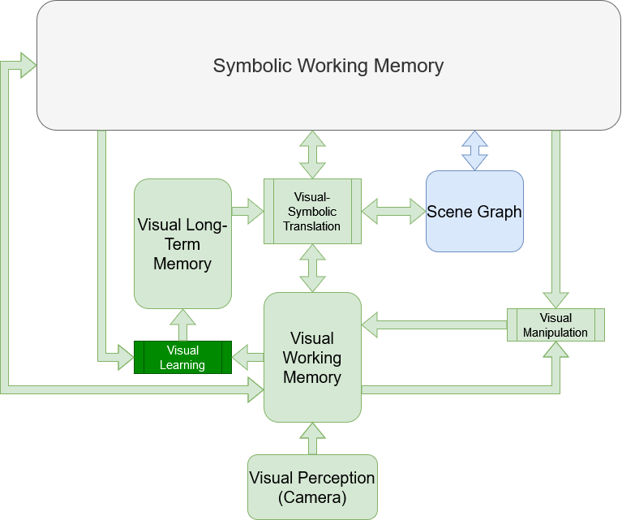
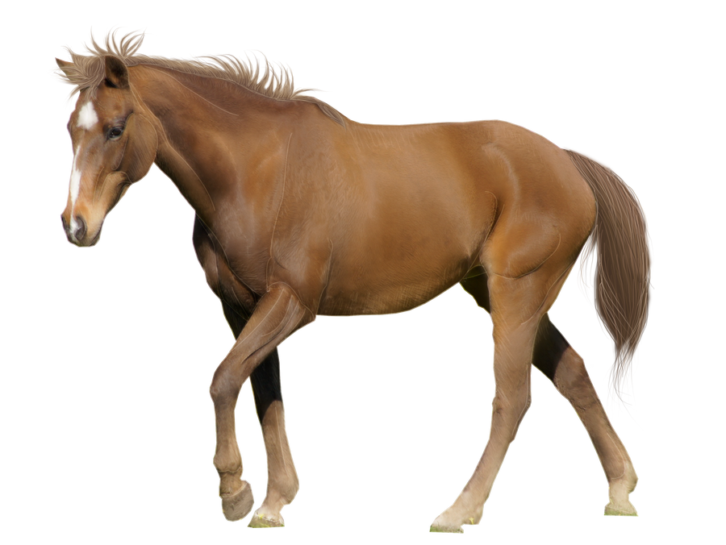


Visual Learning Processes
Compositional:
“Pegasus = horse with wings”
compose

Slide 16
Visual Operators (VOps)
Discrete units of visual reasoning
Composable: explicit inputs and outputs (VOGs)
IMAGE source
blur
IMAGE output
IMAGE source
threshold
10
NUMBER amount
IMAGE
output
0.1
NUMBER threshold
IMAGE
a
add
IMAGE
sum
IMAGE b

Slide 17



Visual Operation Graphs (VOGs)
Feed-forward visual reasoning pipelines
Agent controlled
IMAGE source
IMAGE source
threshold
blur
IMAGE output
IMAGE
output
10
NUMBER amount
0.1
NUMBER threshold
invert
IMAGE
a
IMAGE
output
IMAGE source
multiply
IMAGE
product
IMAGE
b

Slide 18
Visual Working Memory
Symbolic Working Memory
Center for visual reasoning
Stores VOGs, manages automatic updates
Symbolic representation via special WME structure
Visual Working Memory
blur
threshold
10
0.1
add

Slide 19
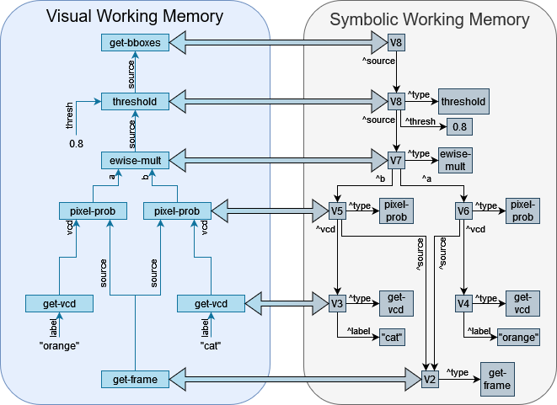
Visual Working Memory

Slide 20
Visual Knowledge Representations
Descriptive Knowledge
Visual Concept Descriptors
Visual Long-term Memory

Slide 21
Visual-Symbolic Translation Revisited
Extractive: symbolic->visual
classify
“cat”
segment
VLTM
Generative: visual->symbolic
“cat”
generate

Slide 22

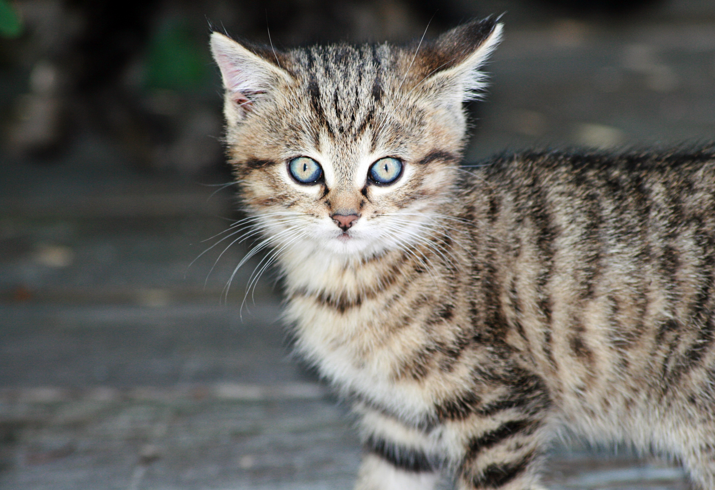


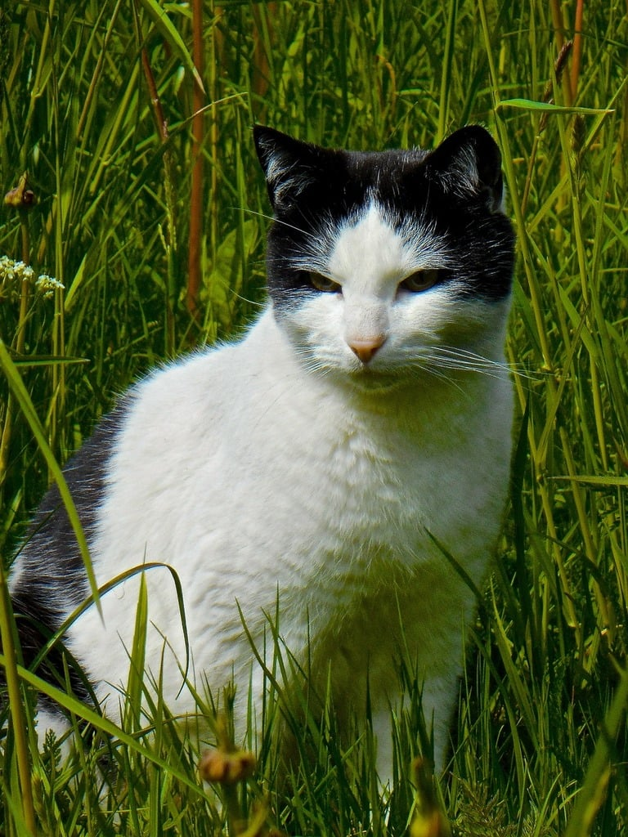

Descriptive Knowledge
V-S translation requires:
recognitive
generative
Compositional learning requires:
discrete
composable
Extractive process
“cat” descriptive knowledge
“cat”
Generative process

Slide 23
Solution: Visual Concept Descriptor
Have a recognizer-generator pair for each visual concept
Abstract away details so all VCDs appear uniform
classify
0.97
Visual Concept Descriptor
recognizer
generator
“cat”
generate

Slide 24
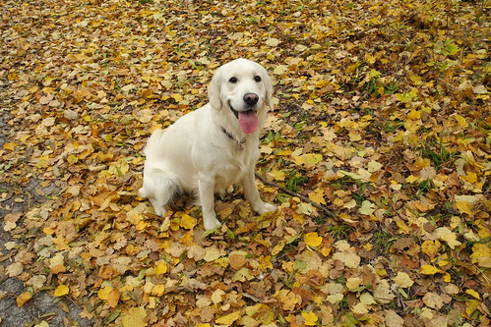
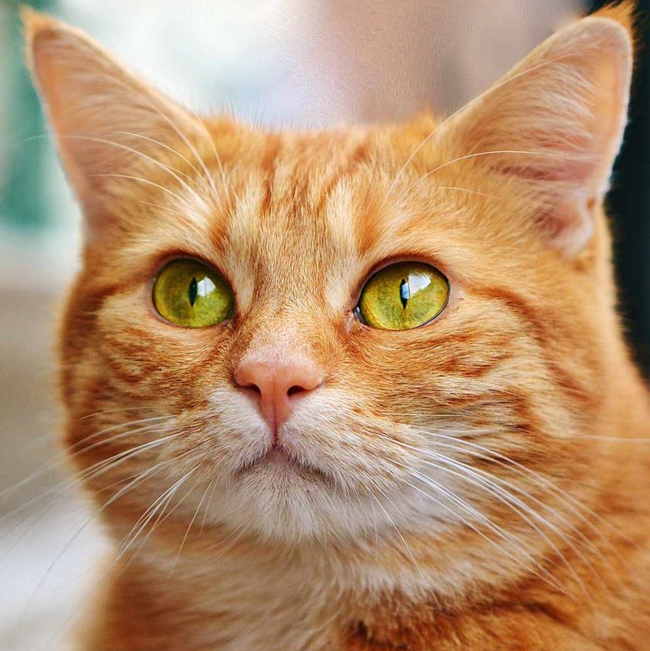
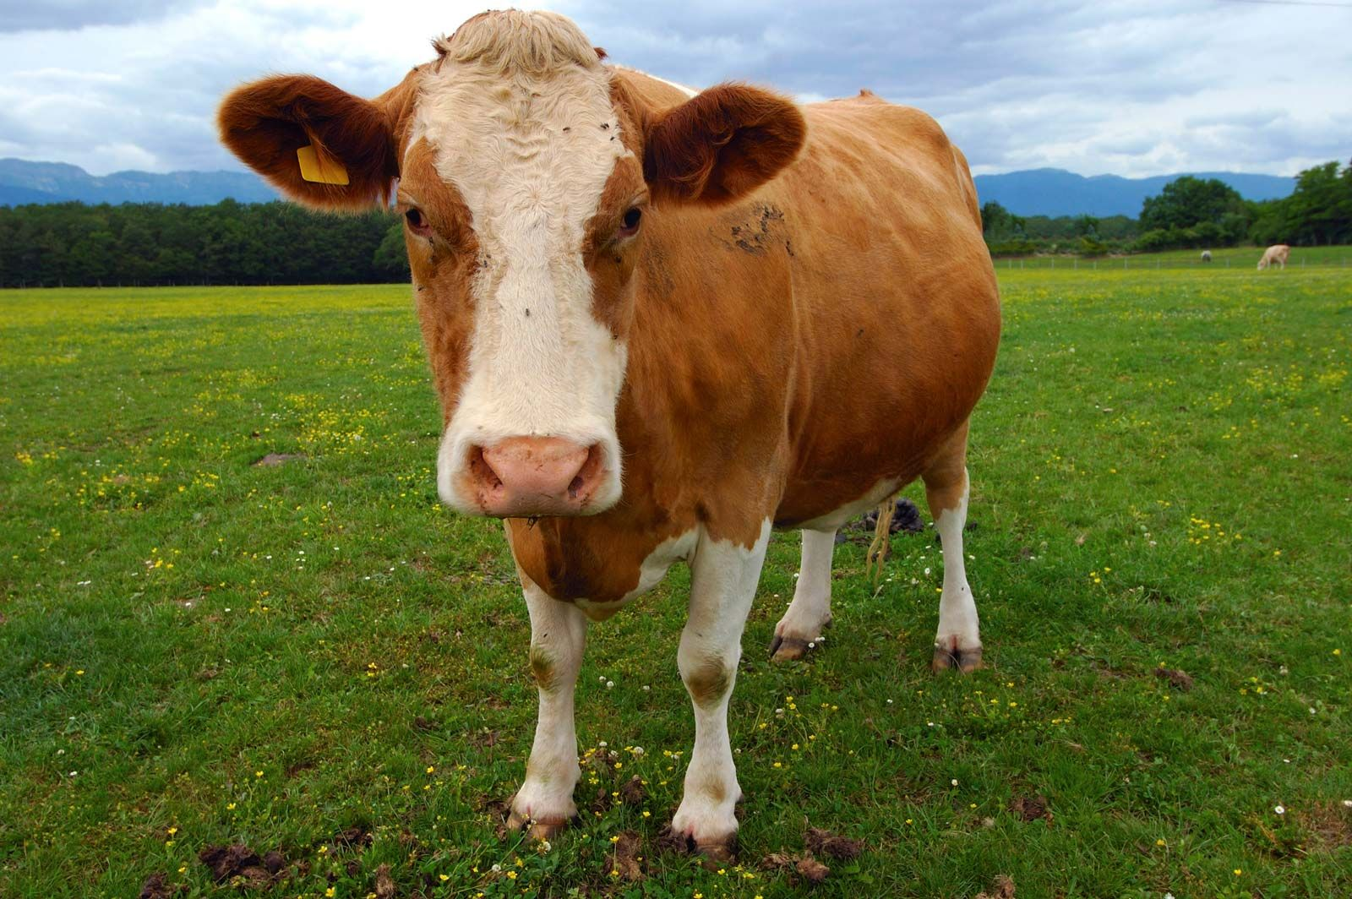
Visual Feature Extraction
Features
Image Encoder
Model 3
Model 2
Model 1
Output
Output
Output
LVMs:
CLIP
DINO
SAM
etc.

Slide 25
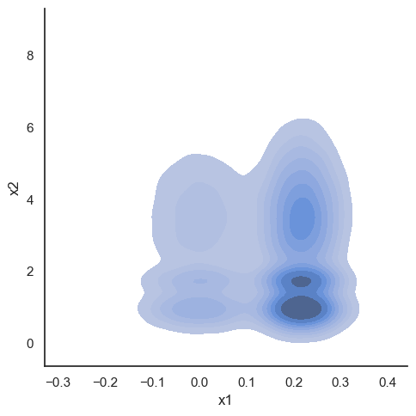
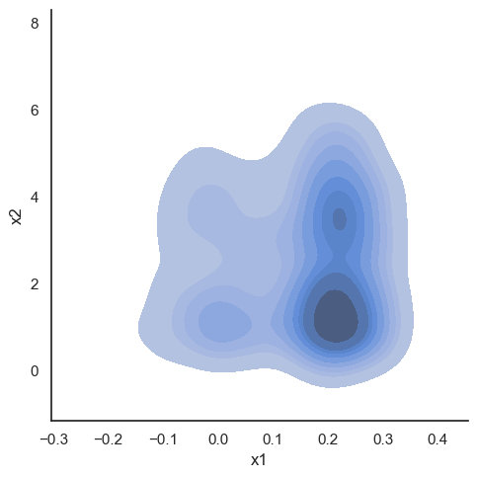
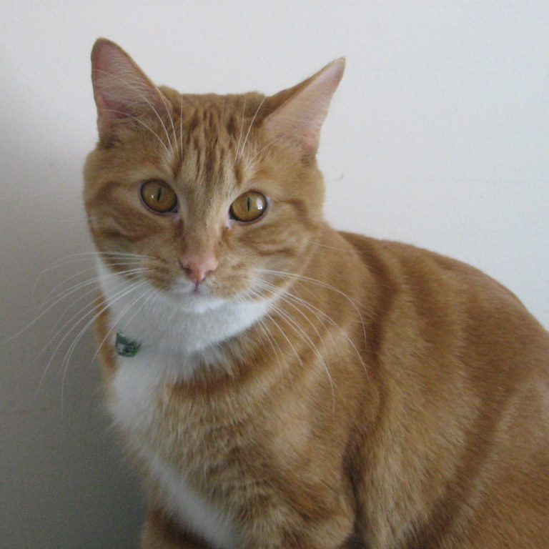

Generative Modeling
Generation: p(x|y)
Recognition: p(y|x)
Recognition: p(x)
Recognition: p(y)
Minimize difference
Generative Model
Estimate

Slide 26
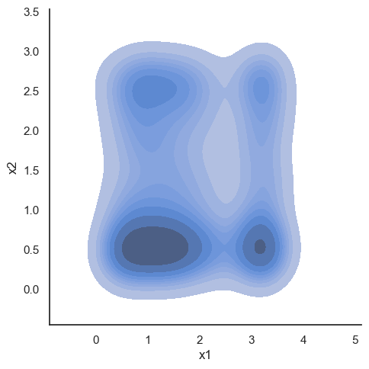
Simplify with Pre-trained Encoders
Image Encoder
classify
0.97
Visual Concept Descriptor
recognizer
cat
generator
Image Decoder
“cat”
generate

Slide 27
Generative Models for VCDs
Visual Concept Descriptor
recognizer
generator
Variational Autoencoder
Encoder
Decoder
P(“cat”)
1.0
P(“cat”)

Slide 28
Generative Models for VCDs
Visual Concept Descriptor
recognizer
generator
Discriminator
Generator
Generative Adversarial Network
P(“cat”)
P(“cat”)

Slide 29
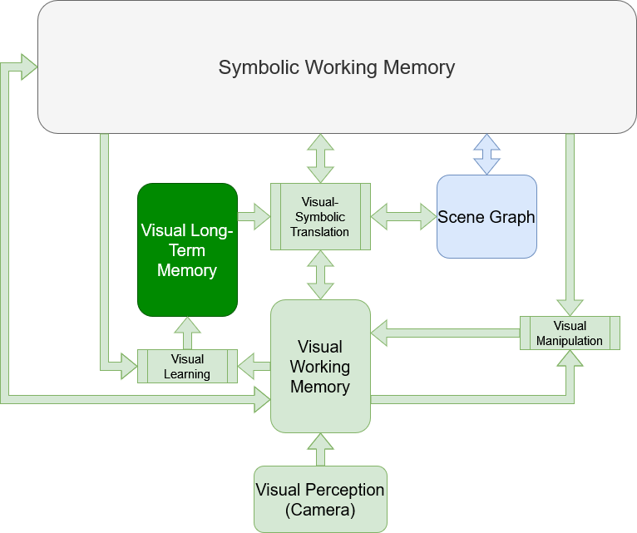
Visual Long-Term Memory
Visual Concept Descriptor
“cat”
“cat”
Visual Concept Descriptor
“dog”
VLTM
classify
generate
Visual Concept Descriptor
“hat”
“cat”

Slide 30
Evaluation
Claim
Levels of Evaluation
Evaluation Individual Capabilities
Evaluating Reasoning
Image Factory

Slide 31
Evaluating Deliberative V-S Reasoning
Domain must require deliberative visual-symbolic reasoning
No satisfactory benchmarks/domains:
Either single-step problems or require motor control
Creating novel evaluation domain: Image Factory
Low-level visual processing
High-level symbolic processing
Objects are green square and blue triangle
Area of a triangle = 0.5b*h, area of a square = b*h
Square has twice as much area, so need two triangles to cover it
After putting one triangle on the square, two half-triangles of green are left, so cut second triangle in half
No more green visible, so we’ve shown we can cover the green object with two of the blue object

Slide 32
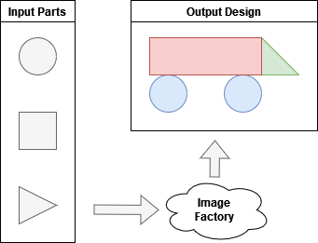
Image Factory
Inspired by factory games (shapez, Factorio)
Objective: given input parts, design a factory which uses machines to assemble the inputs into a specified output product
Parts, product = images
Machines = image transforms
Solution = factory layout

Slide 33
Image Factory
Inputs, outputs, or both might be symbolic rather than visual
E.g., “using a grey square and a grey circle, make a tree”
Number and type of machines can be fixed as part of task spec
E.g., “you may only use one rotate machine for this task”
Tasks can build on each other in task sets:
E.g., “using the output of your last factory, produce the product”

Slide 34
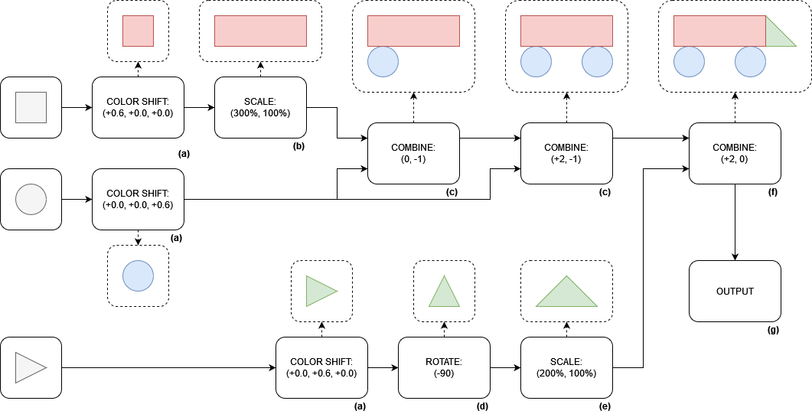
Image Factory Example
Problem Spec

Slide 35
Progress/Future Work Summary
Completed Work
Future Work
Initial VWM and VLTM memory structures
Single-image VCDs
Image manipulation VOps
Neural VCDs:
Integrating LVM(s) into SVS2
Integrating generative models into SVS 2
VCD composition
Learned neural VOps(?)

Slide 36
Outline
Motivating Example
Deliberative Reasoning
Revisit Objective
Revisit Proposal
Why This Approach?

Slide 37
Outline
Cognitive Architectures
Soar
SVS
Feature Extraction
Generative Modeling

Slide 38
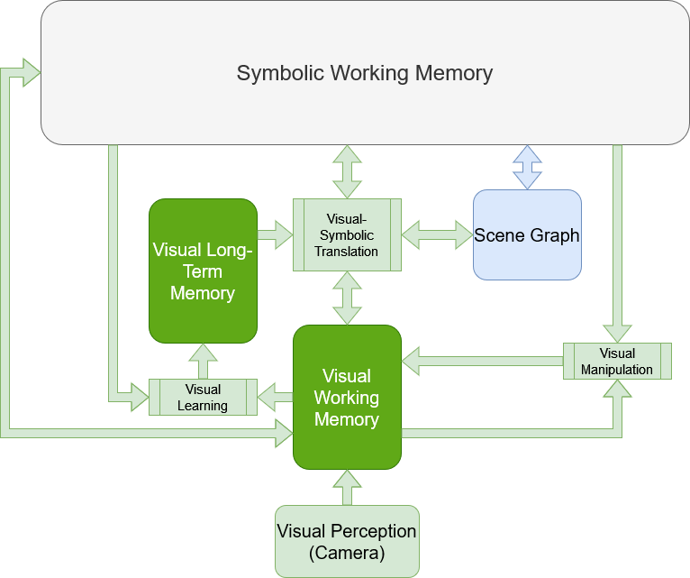
SVS2 Memories Overview
VWM:
Short-term task/sub-task relevant knowledge and reasoning
Depictive knowledge
Manages visual reasoning
VLTM:
Long-term visual concept knowledge, persists through the agent’s lifetime
Descriptive knowledge
Notes:
The two memory systems in SVS2 are VWM and VLTM. VWM is the

Slide 39


S1
N1
N2
N3
N6
^svs.vwm
^operation
“get-frame”
^target
^target
^target
^operation
“greyscale”
^operation
“crop-to-ROI”
^operation
“template-match”
V3
^x
8
^template
^y
188
^node
^width
144
^node
^height
8
^node
N4
N5
^node
^node
^operation
“get-from-vltm”
^target
^node
^archetype
“paddle”
^operation
“greyscale”
N1
N2
N3
N6
N4
N5

Slide 40
Problem: Need encoder/decoder pair
Image Encoder
recognizer
“cat”
“cat”
generator
Image Decoder

Slide 41
Problem: Need encoder/decoder pair
Image Encoder
recognizer
“cat”
Image Encoder
Image Decoder
Best case
Image Encoder
Learned Mapping
Image Decoder
Potential solution
Custom-trained Image Decoder
Image Encoder
Worse solution

